Slide 1
Culture report - Russia
Vadim Zubchenko, Rasmus Julin, Hannu Korhonen, Sami Sikkilä

Slide 2
In some ways similar to finnish culture
Finds over-smiling awkward
Only smile when something is funny or you are happy
Privacy is important
Handshakes are necessary in meetings
Time concept
Being late is not the end of the world
Gifts are expected in special occasions

Slide 3
And in other ways not so similar
Conversations
Touching
Close contact
Talking with hands
It is important to look wealthy
Fancy car
Expensive clothes
You don’t question the wealth of others in person
Showing off
Showing appreciation
Small talk
Silence is bad
Mostly the decisions are done by men
Gender equality is a bit old-fashioned

Slide 4
Touching
Grabbing the shoulder while talking
Friendly hugs
Women and men can be hugged
Placing hand on the waist while hugging a woman
Shaking the hand of everyone in the meeting
Kissing women on the cheek

Slide 5
Example of bad behaviour
Timo arrives to the meeting wearing fur cap and fur jacket
Timo complains about Vladimir being 10 minutes late
Timo doesn’t shake Vladimirs hand firmly and makes eye contact
As small talk Timo asks if Vladimirs ring is genuine
Vladimir invites Timo to the dinner table but Timo answers that he has eaten already

Slide 6
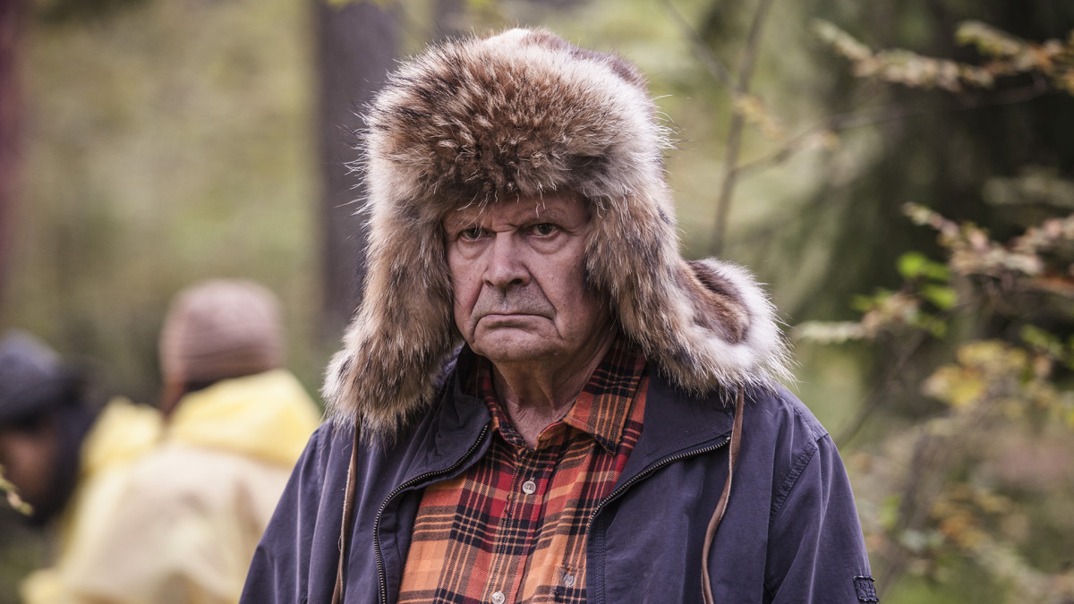
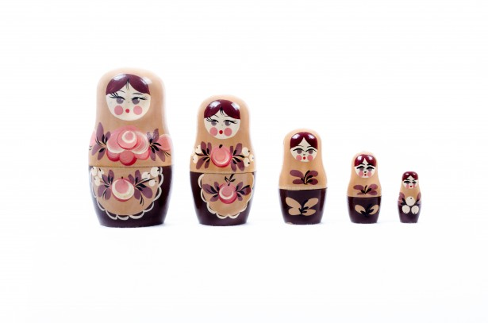
Things to be avoided
Unnecessary smiling
Inquiring too much
Looking straight at eyes
Asking too personal questions
Stereotyping
Giving stereotypical gifts like matryoshka
Wearing stereotypical clothes in attempt to bond

